Slide 1
Strategy A1d ATOD Policies in Schools
Tanya Henderson, B.A., C.P.S.
Community Program Manager
Shannon Morrison, Ph.D
Local Evaluator

Slide 2
Curry county schools

Slide 3
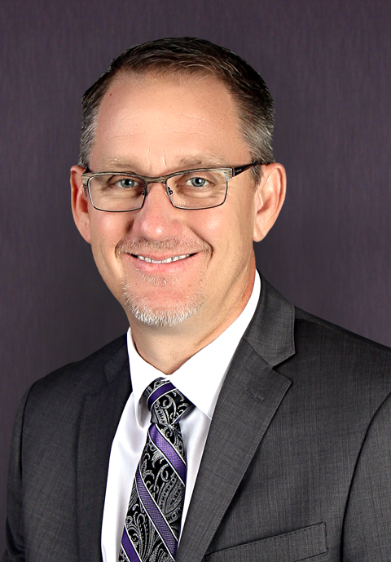
Joe Strickland
Deputy Superintendent of
Student Instruction
Primary contact for Clovis
Schools
Key coalition
stakeholder

Slide 4
Started with a student
A Clovis High School student came to school high
Pulled aside due to suspected use of drugs
When student was questioned, student was honest
Student Hearing
Automatically suspended
Up to 1 year
Had school history of incidents with drugs, 2nd offense

Slide 5
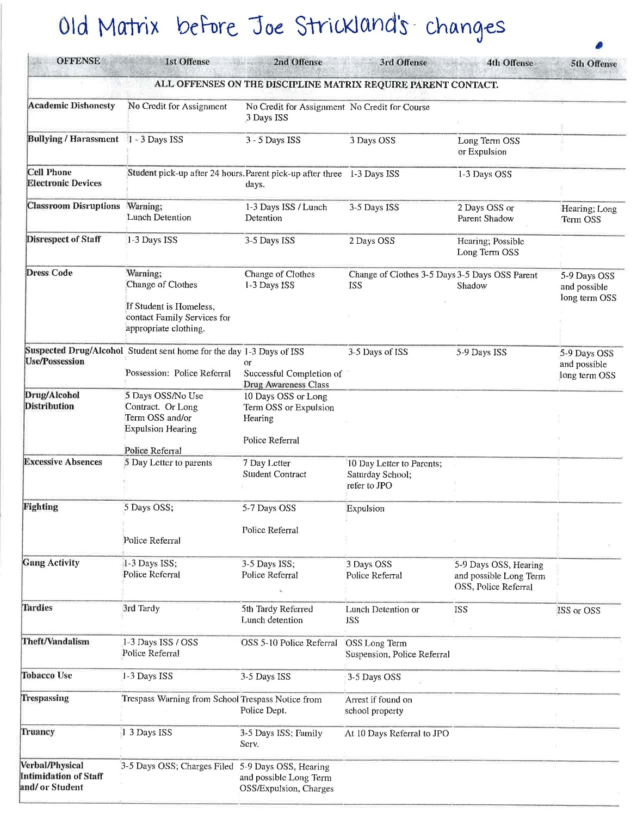
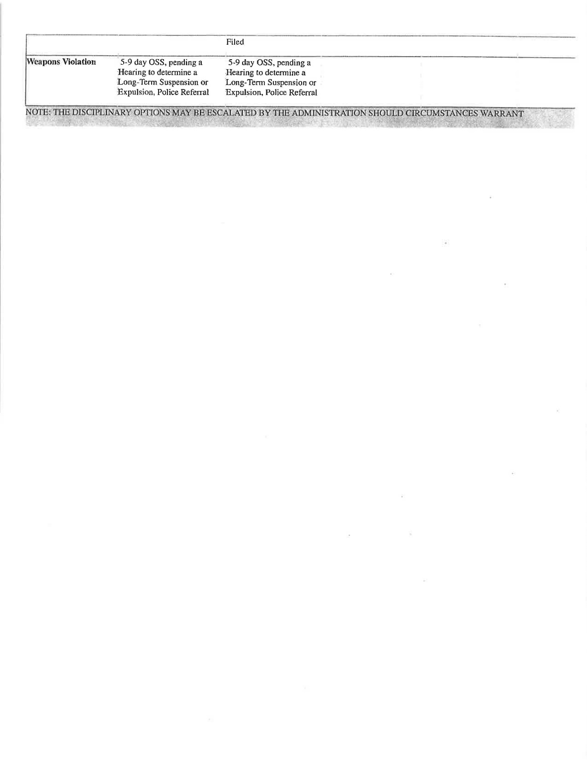

Slide 6
Other concerns
Discipline matrix
Secondary schools only (6th – 12th grades)
Disciplinary Personnel decisions
Bias repercussions between students:
i.e. athletes vs student not in extra-curricular activities
Made their own consequences for the student
Judge, jury, and executioner mentality
No parent access

Slide 7
Strickland’s goal
Keep kids in school
Separate felony & misdemeanor offenses
Add education & psychology help
Reduce out of school suspensions & explusions

Slide 8
His process
Discipline Matrix
Old
Needed to be updated
Legal Firm
Santa Fe
Advice & Recommendations
Meetings
20+ formal
70+ informal
OSAP Program
FY16
NEW Matrix
Finalized
Started SY 17 – 18

Slide 9
OSAP CONTRIBUTIONS
Active members of discipline matrix meetings
Supporter of elimination of expulsions & out of school suspensions
Asked questions
Keep conversation going
Addition of Youth Services
Free services of counseling classes

Slide 10
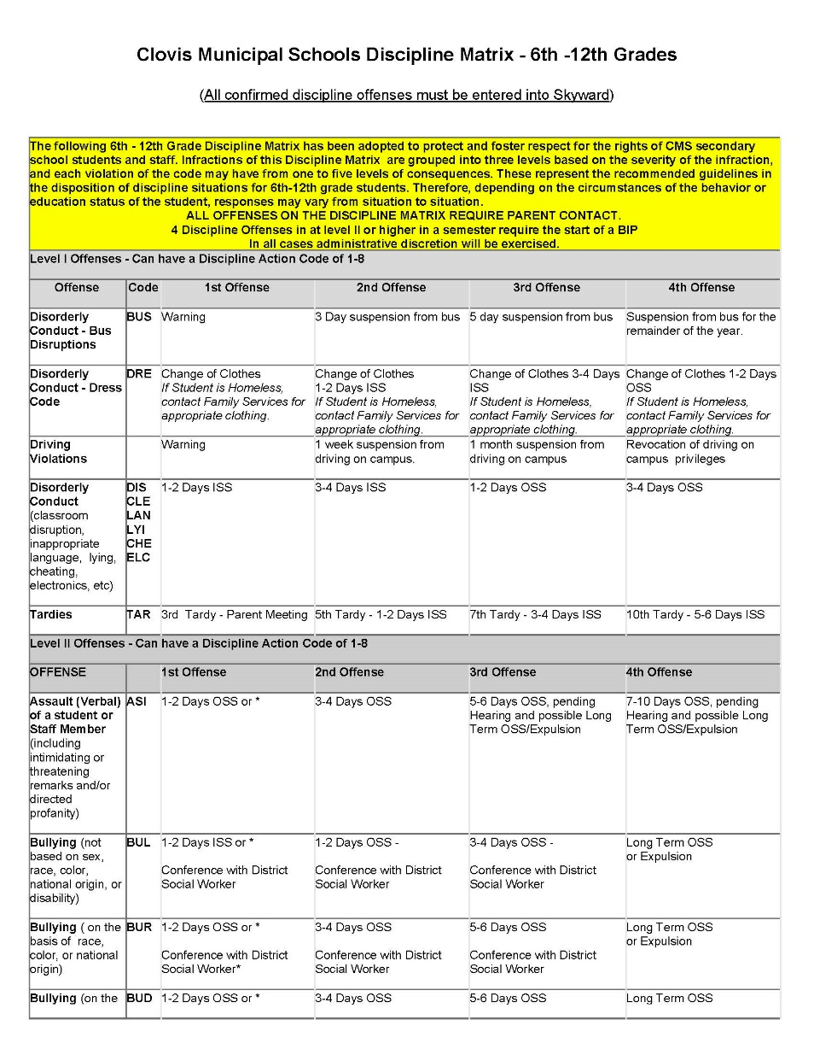
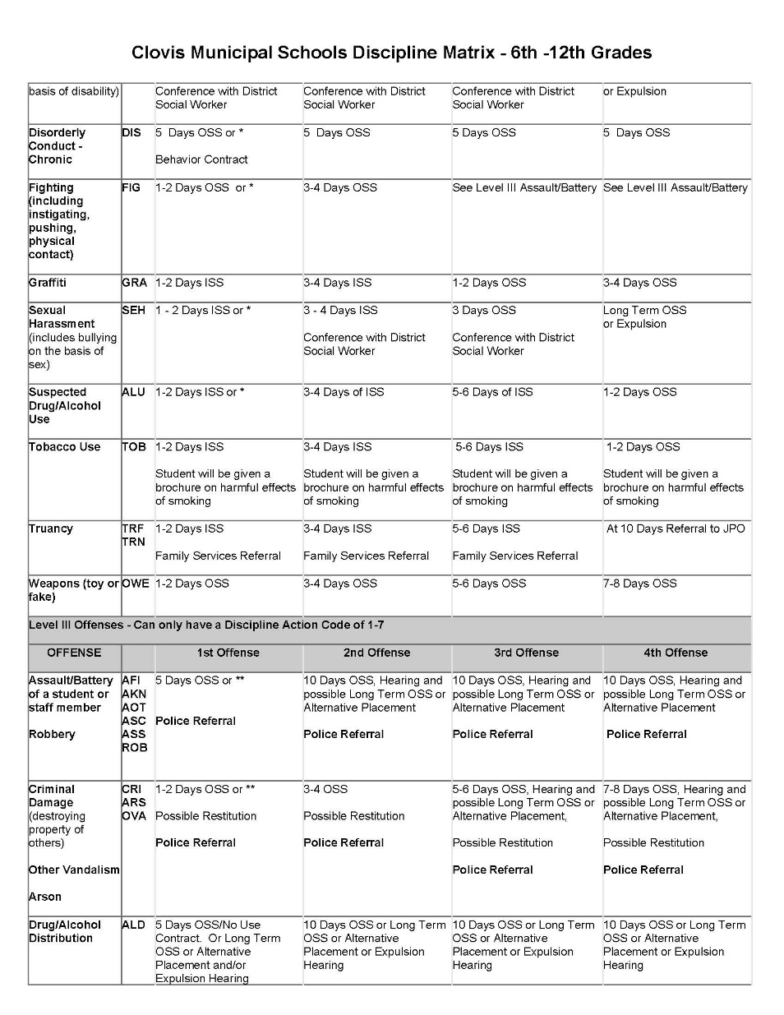
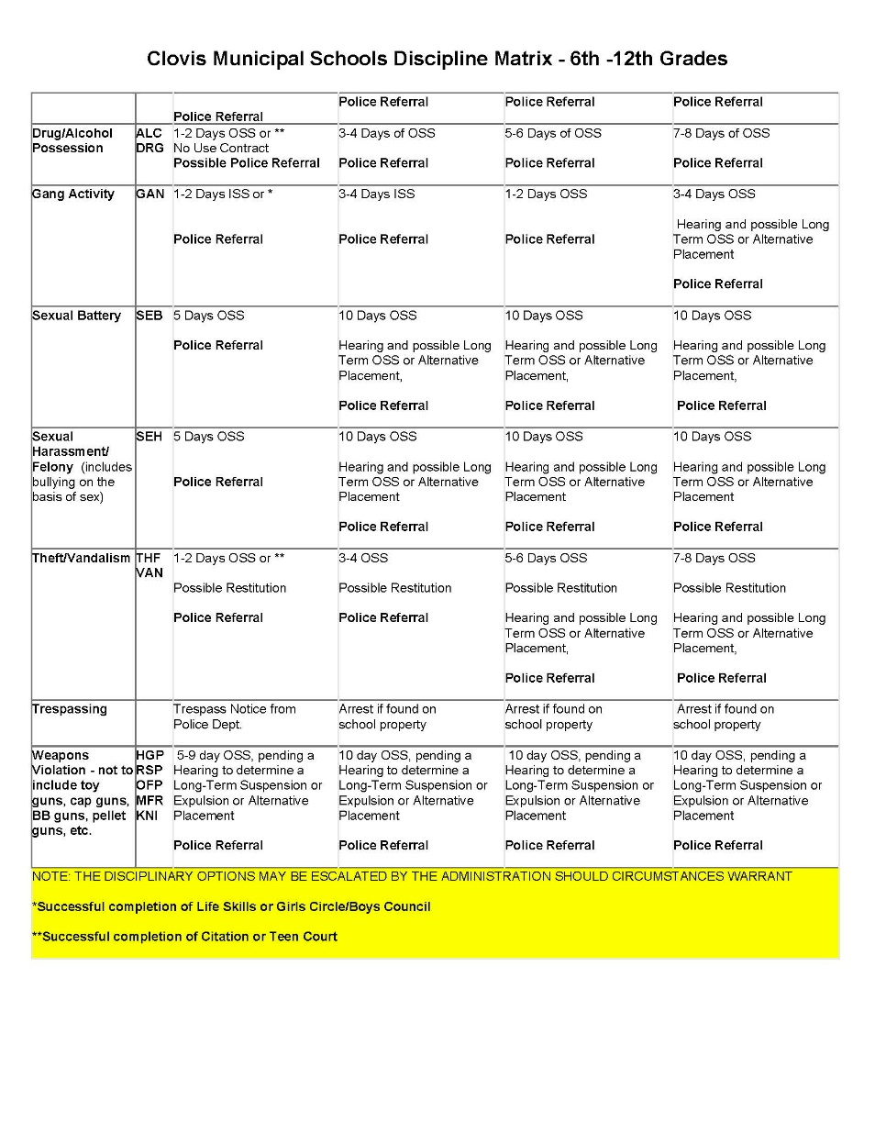

Slide 11
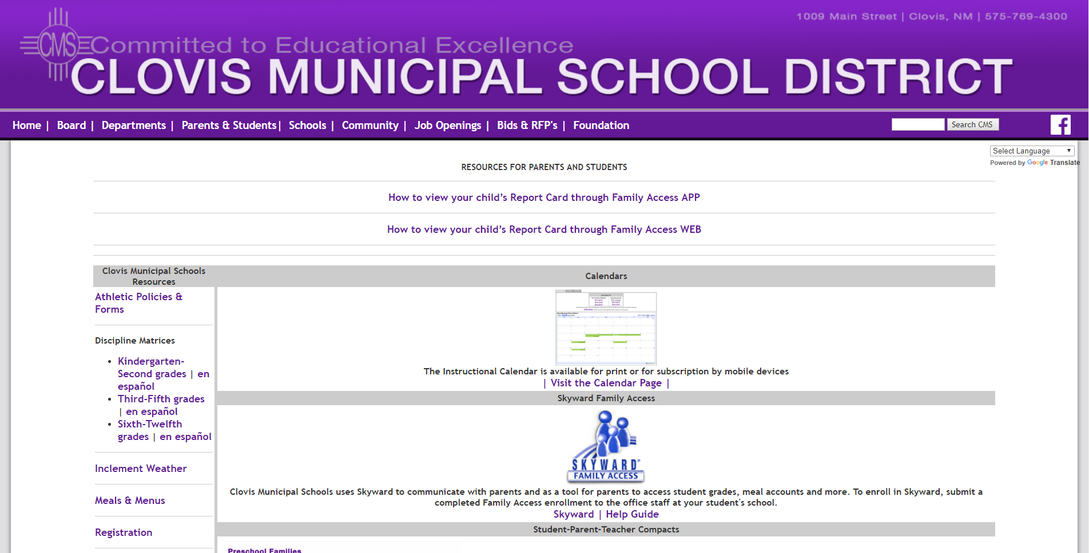

Slide 13
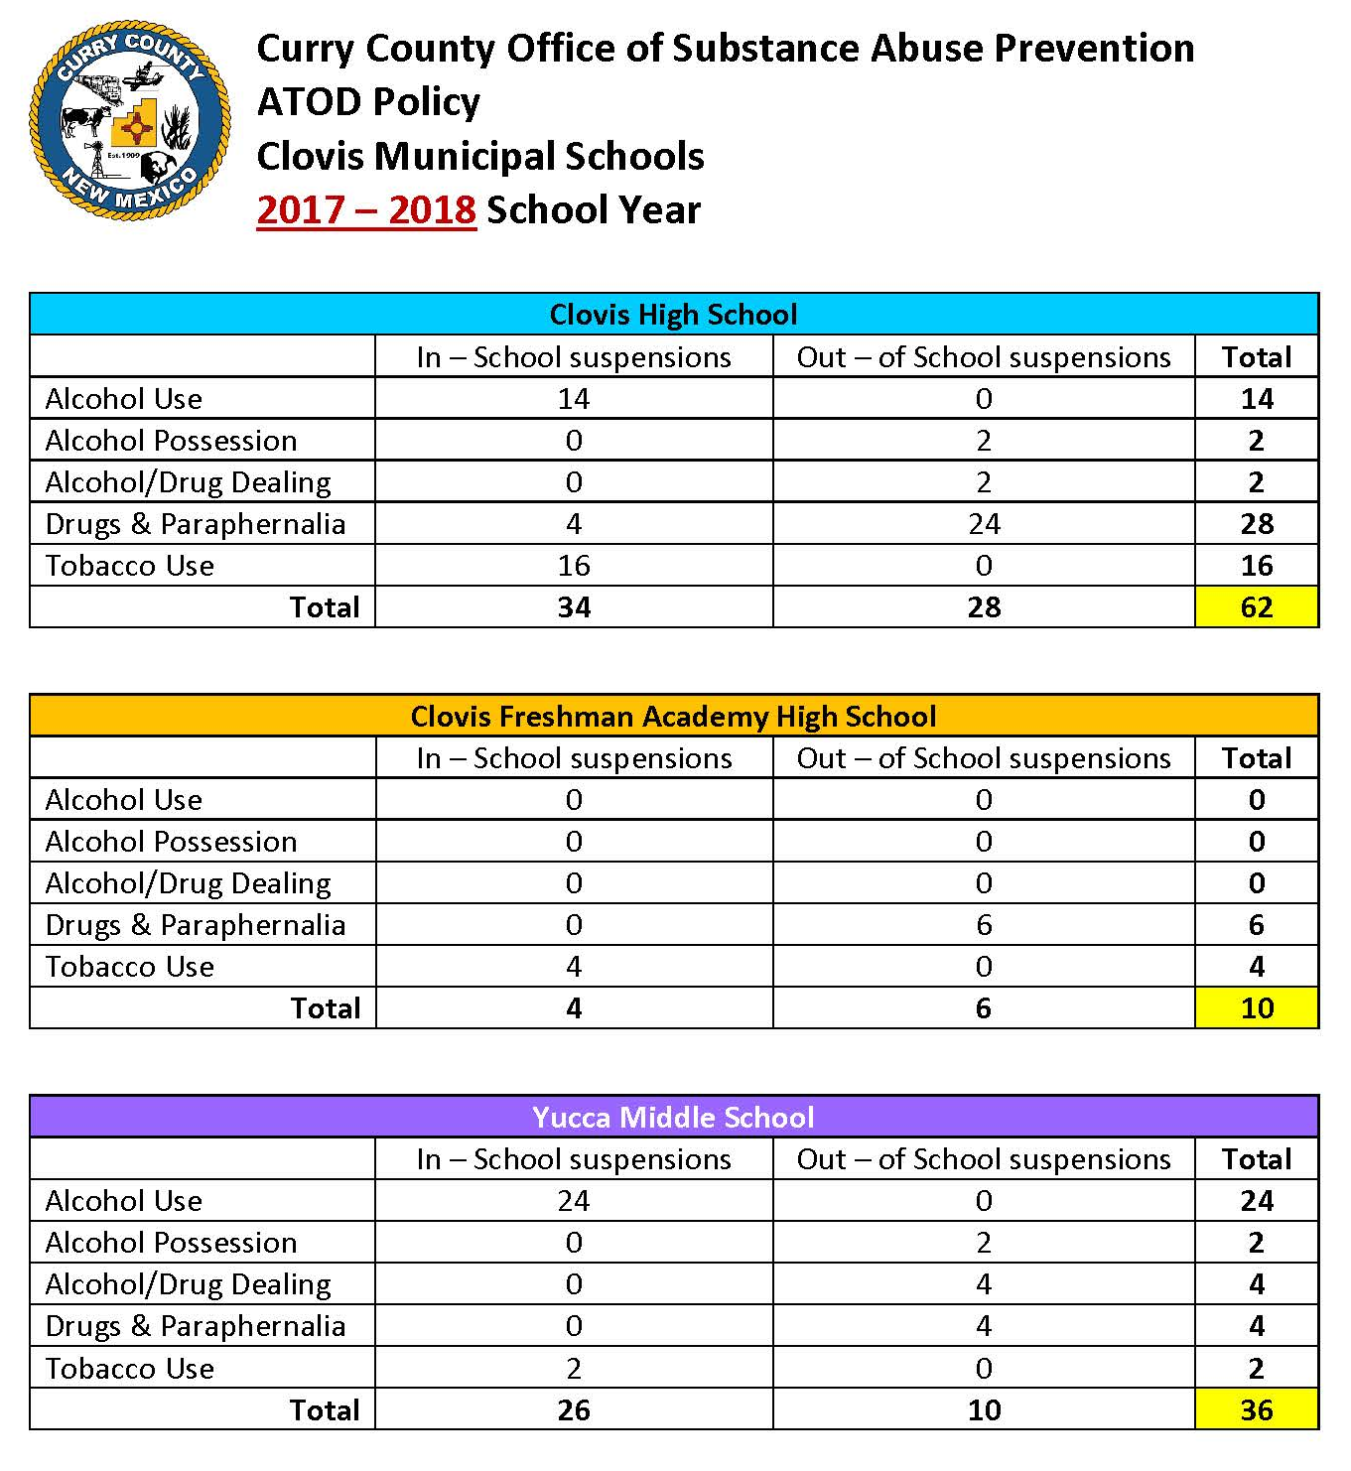

Slide 15
The # of in-school suspensions increased and # of out-of-school suspensions decreased between school years 2018 and 2019 for clovis municipal schools.

Slide 16
Challenges & barriers
2 Strong Personalities
Lack of parent groups
Getting public support
Severe punishment vs open-minded
Plenty of meetings, but hardly any parents
Getting people to understand
Just jumped in there

Slide 17
Strickland’s advice
Stakeholder Groups
Parents
Community
Legal Council
Basic strong foothold
Overall
Bigger stakeholder group
Not just CMS personnel
Better received
Easier transition
Helps with policy change

Slide 18
Questions? Comments?
Thank you.
Tanya Henderson, BA, C.P.S.
thenderson@currycounty.org
(575) 763 – 7725 ext 164

